Slide 1

Qualifying Exam - Oral
Eric Liao

Slide 2
Outline
Why study metabolic signature
Workflow
PLS-DA
Study example (ST000058)
Results and validation
Future plans

Slide 3



Why study Metabolic Signatures?
In the past decade, the popularity of metabolomics has led to the number of studies in public repositories increase rapidly.
We want to data-mine in public data available repositories, such as Metabolomics Workbench and Metabolights.
The studies in public repositories are from different diseases, using different platforms and different sample source. We try to find a way to relate similar studies together. And one way of doing this is to look for robust metabolic signatures.
[1] Gowda GA, Zhang S, Gu H, Asiago V, Shanaiah N, Raftery D. Metabolomics-based methods for early disease diagnostics. Expert Rev Mol Diagn. 2008 Sep;8(5):617-33. doi: 10.1586/14737159.8.5.617. PMID: 18785810; PMCID: PMC3890417.
Notes:
With all these available data, we attempted to discover and evaluate potential biomarkers that presented in similar studies with different labs.
What is metabolic signatures: Traditionally, a single biomarker is used for disease diagnosis. But metabolic diseases are very complex that usually include many metabolites. Untargeted mass spectrometry-based metabolomics studies could detect thousands of compounds in one analysis. The set of metabolites that distinguish phenotypic groups and can be used for disease diagnosis is termed as metabolic signatures

Slide 4
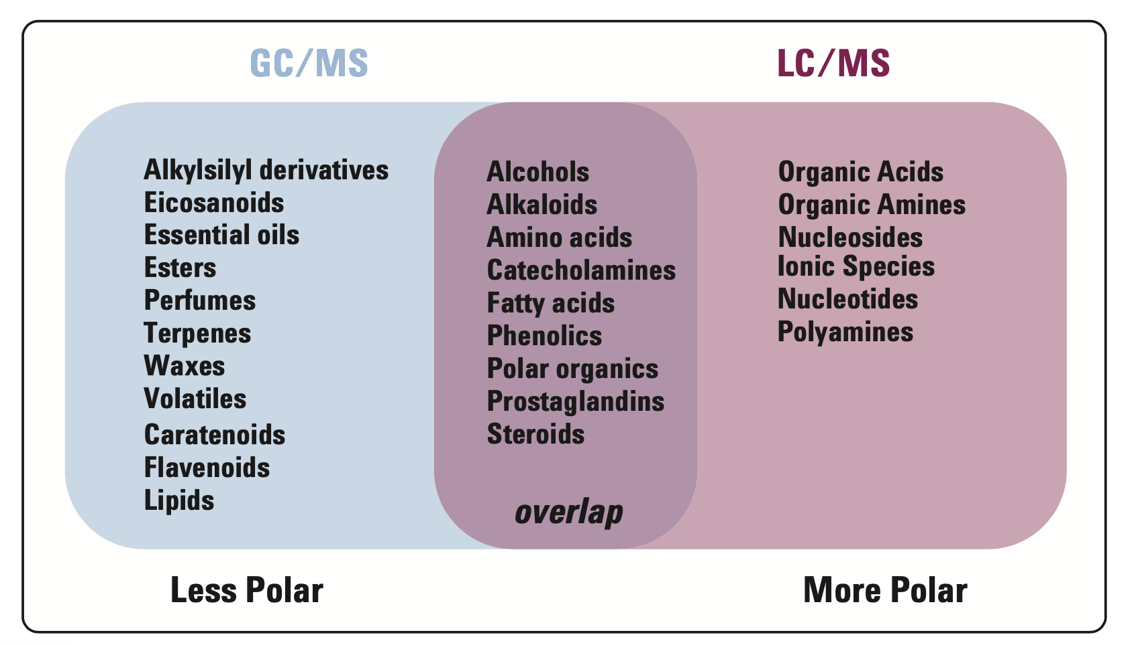
GC-MS vs. LC-MS
GC-MS | LC-MS
Volatile | More polar
Less Polar | Nonvolatile
Thermally stable | Thermally fragile
Molecular weights < 1250 u
https://sciencing.com/difference-molar-mass-molecular-weight-8611435.html
Notes:
which is more sensitive, GC-MS or LC-MS?
First and foremost, GC/MS methods tend to need a higher sample volume than LC/MS/MS methods. GC/MS is a less sensitive instrument, which means more sample is needed to achieve lower limits of quantitation (LOQs). Many LC/MS/MS methods only require 50-200 μL of sample.

Slide 5
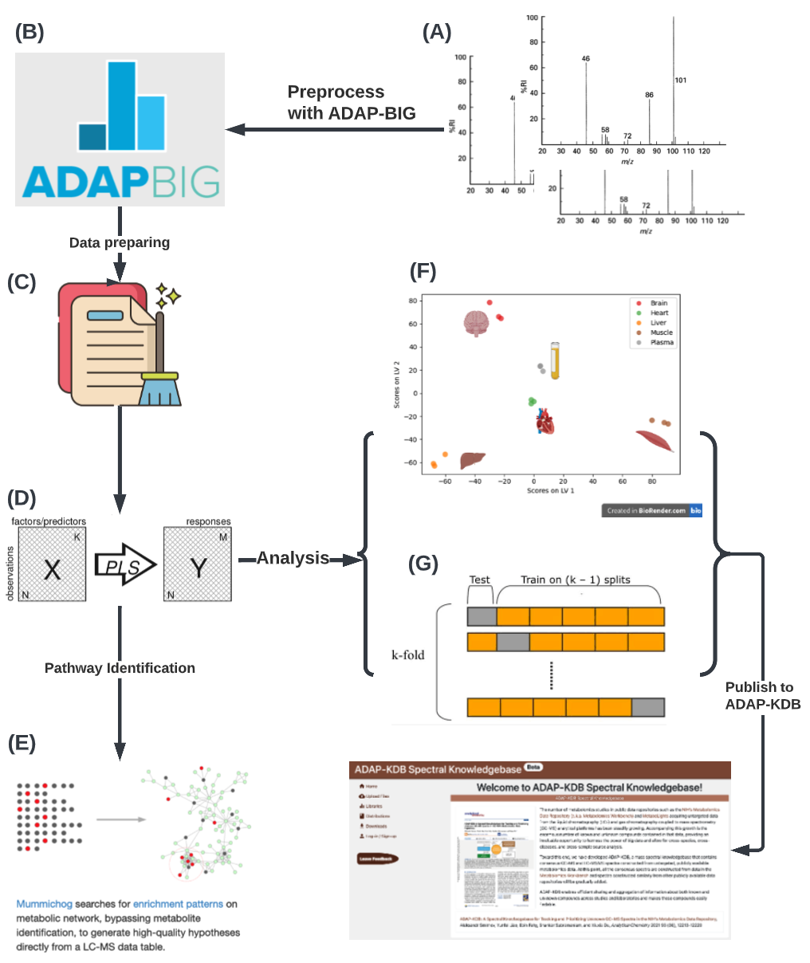
Currently Workflow for Metabolic signature discover using GC-MS and LC-MS studies
Notes:
Here we choose PLS-DA, one thing is:
1. PLS-DA can analyze highly colinear and noisy data
2. metabolomics studies have large volume and large number of features; it will be hard to interpret the data by our eyes. PLS-DA which can provide a low-dimensional, easily interpretable scores plot. This can give us a clear idea of the separation of each sample group.
3. PLS-DA provides some statistics, such as loading weights, variable importance on projection (VIP), that will help to identify the most important variables
Reason for why not choose Random forest:
1. RF with its associated GINI feature importance allows for an explicit feature elimination but may not be adapted to spectral data due to the topology of its constituent classification trees which are based on orthogonal splits in feature space.
2. A large of trees can make the algorithm too slow and ineffective for real-time predictions.
3. The author also shows that PLS-DA outperform RF in terms of classification. s

Slide 6
Why choose PLS-DA
 | PLS-DA | SVM | RF
Pros | Resistant to multi-collinearity and a larger number of variables than observations Handles noisy data Robust classifier that can separate multiple groups Reduce dimensionality | Not influenced by the distribution of samples Target both linear and non-linear data (depend on kernel) Robust to noise and outliers No local minima | Handles thousands of input variables without variable deletion Ability to handle missing values Robust to overfitting and outliers Handles data without pre-processing Handles noisy data
Cons | Tendency to overfitting and model validation is essential Scores plot may present an over-optimistic view of the separation between the classes Identify small numbers of variables that related to the separation between samples classes is difficult | Computational expensive with large number of classes Selection of parameters Solves only two class problems Variable selection is rather abstract | Complex visualization of output decision trees due to large number of trees Selection of parameters however in many cases default values are essential Higher correlation between any two trees in the forest increases the forest error rate, therefore, sensitive to the number of variables selected at each node
https://www.sciencedirect.com/science/article/pii/S0003267015001889?via%3Dihub#bib0015

Slide 7
Why Choose PLS-DA
Metabolomics study data has large volume, large number of features, noise and missing data.
Because of the complication of data, it will be hard to interpret the data by human eyes. (PLS-DA can provide a low-dimensional, easily interpretable scores plot)
PLS-DA provides some statistics, such as loading weights, variable importance on Projection (VIP), that will help to identify the most important variables, in our case, to identify the biomarkers.
PLS-DA is commonly used for classification purpose and biomarker selection in metabolomics studies and other omics studies.

Slide 8
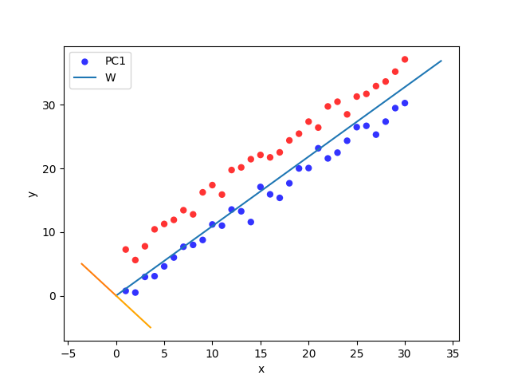
why not univariate statistics?
The metabolomics dataset usually has a large number of features, and features are collinear.
Notes:
Univariate analysis is the analysis of one variable. Multivariate analysis is the analysis of more than one variable. There are various ways to perform each type of analysis depending on your end goal. In the real world, we often perform both types of analysis on a single dataset.

Slide 9
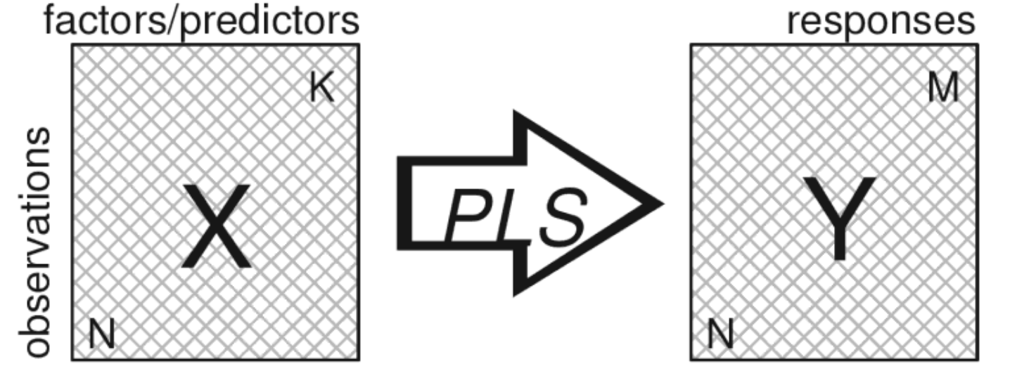
PLS
PLS is used to relate two data matrices, X and Y, to each other by a linear multivariate model.
It is able to analyze data with many, noisy, collinear, and even incomplete variables in both X and Y.

Slide 10
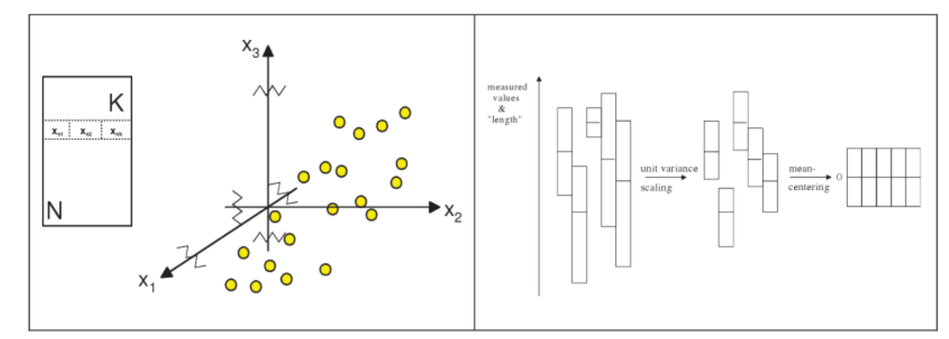
PLS
Basic data pre-process for PLS
Notes:
The purpose of normalization is to change the values of numeric columns in the dataset to a common scale, without distorting differences in the ranges of values.
Mean-centering: doing so will help reduce multicollinearity in a regression model.
Example why normalization: Let’s say we have a dataset containing two variables: time traveled and distance covered. Time is measured in hours (e.g. 5, 10, 25 hours ) and distance in miles (e.g. 500, 800, 1200 miles).
One obvious problem of course is that these two variables are measured in two different units — one in hours and the other in miles. The other problem — which is not obvious but if you take a closer look you'll find it — is the distribution of data, which is quite different in these two variables (both within and between variables).

Slide 11
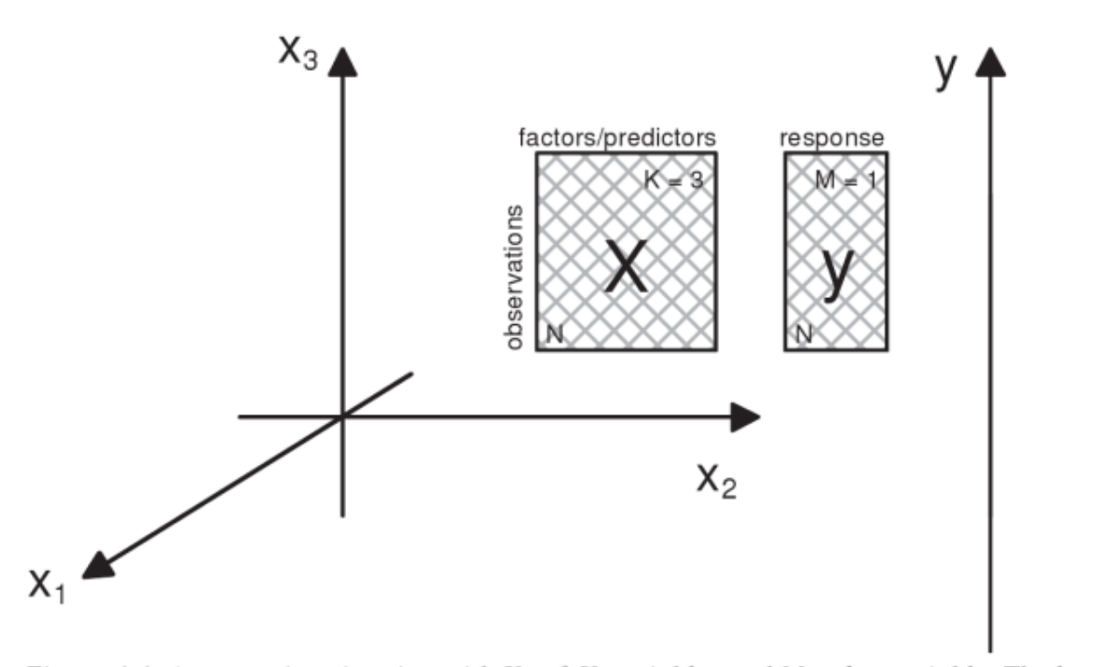
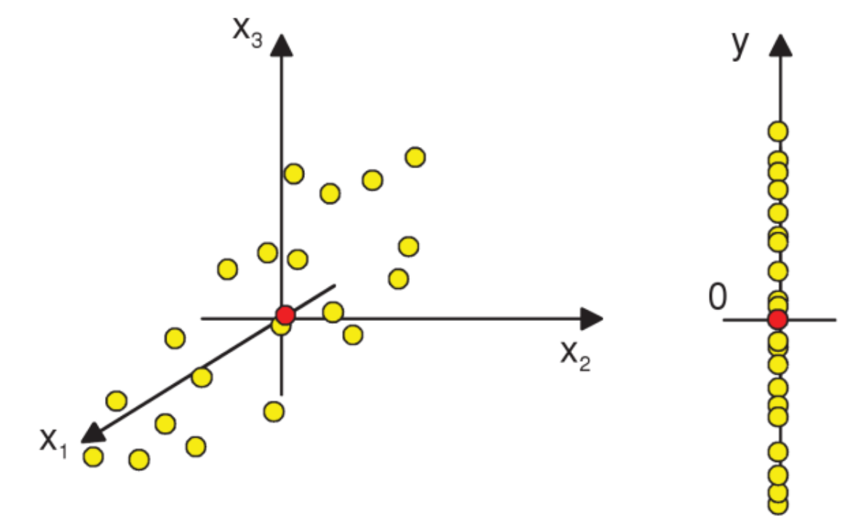
The geometry of PLS
Case: N observations, K = 3 X-variables, and M = 1 y-variable
The two variables spaces can be represented as below:
Here, each row in data table corresponds to two points, one in the X-space and one in the Y-space

Slide 12
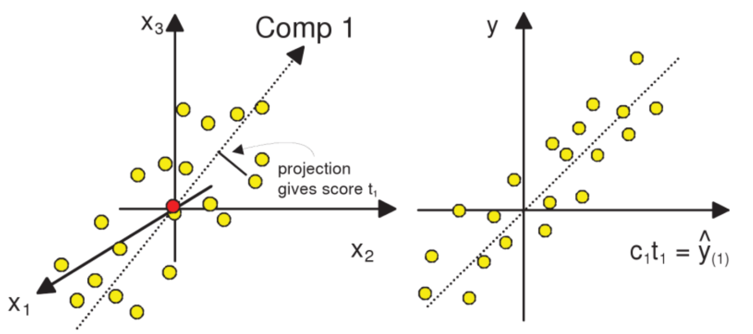
The first PLS component
The first PLS component is a line in the X-space which well approximates the points and provides a good correlation with the y-vector.
Scores: The coordinate of an observation along this line is obtained by projecting the sample onto the line. This coordinate is termed the score, t_{i1}, of observation i.
The first X-score vector t₁ is formed by the scores of all the observations.

Slide 13
The first PLS component
The score vector t1 can be considered a new variable, a latent variable. This reflects the information in the original X-variable that is of relevance for modeling and predicting the response variable.
A model estimate of y, ^y₍₁₎, after the first PLS component, is accomplished by multiplying t₁ by the weight of the y-vector, c₁.

Slide 14
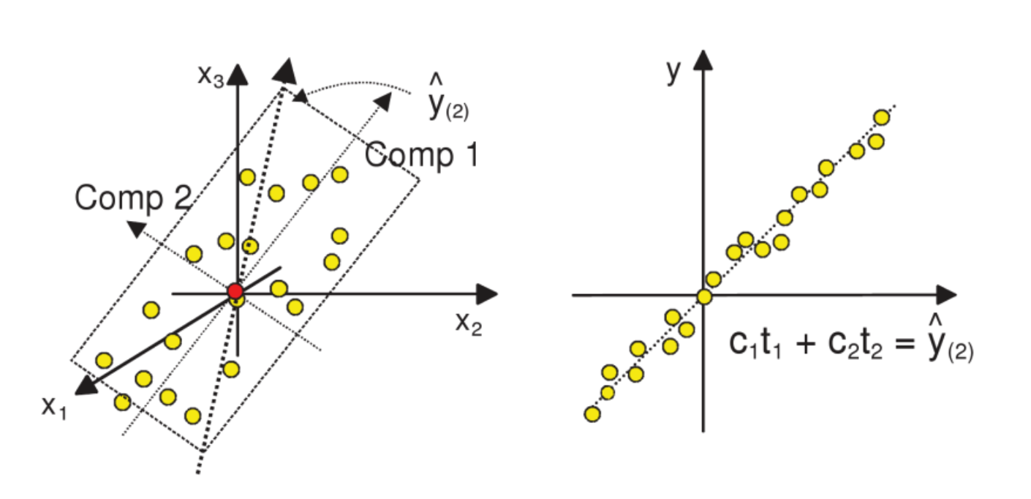
Extending with the second component(M = 1 Y-variable)

Slide 15
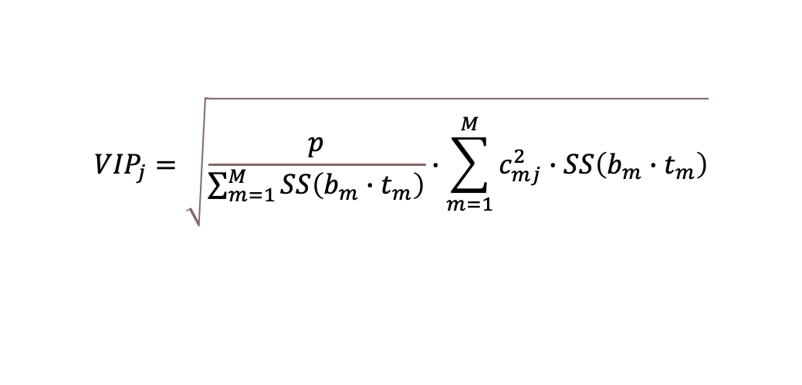
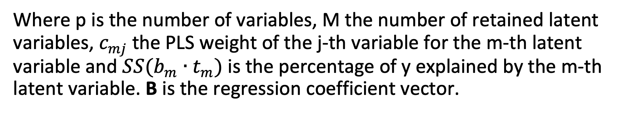
Variable Influence on Projection (VIP)
VIP is a weighted sum of squares of the PLS weights, c*, taking into account the amount of explained Y-variance in each dimension.
The VIP score for the variable j is defined as:
Notes:
The "weights" in a PLS model are used to translate E_a (the deflated X matrices) to a column in the scores matrix t_a. Deflation occurs after each step of the algorithm by subtracting the variance accounted for by the new component. Loadings on the other hand, translate T to X.
If vip score is greater than 1, the variable has more than expected importance in terms of the predictioness of the model.
https://eigenvector.com/different-kinds-of-pls-weights-loadings-and-what-to-look-at/
1- We calculate cor2, the correlation between the Y variables, and the PLS components associated to the X data set, squared cor(object$Y, object$variates$X, use = "pairwise")^2. It returns a matrix of size P x H where P is the number of variables in X and H is the number of components.
W = loading vectors from X, for each component h.
2 - We calculate the redundancy value Rd. For H = 1, Rd = W^2 (loadings squared). For H >1, Rd = the sum of cor2 of all Y variables, for each component (this is when you have more than 1 Y variable)
3 - For a given variable from X and a given component, the VIP is defined as sqrt(P * Rd %*% t(W^2)/sum(Rd))
What is means is that we assess the importance of a variable from X to explain all variables Y (through the Rd calculation), while also taking into account its loading weight W^2. However,
sum(Rd) takes into account all components, whereas the rest of the elements in the equation are component based.

Slide 16
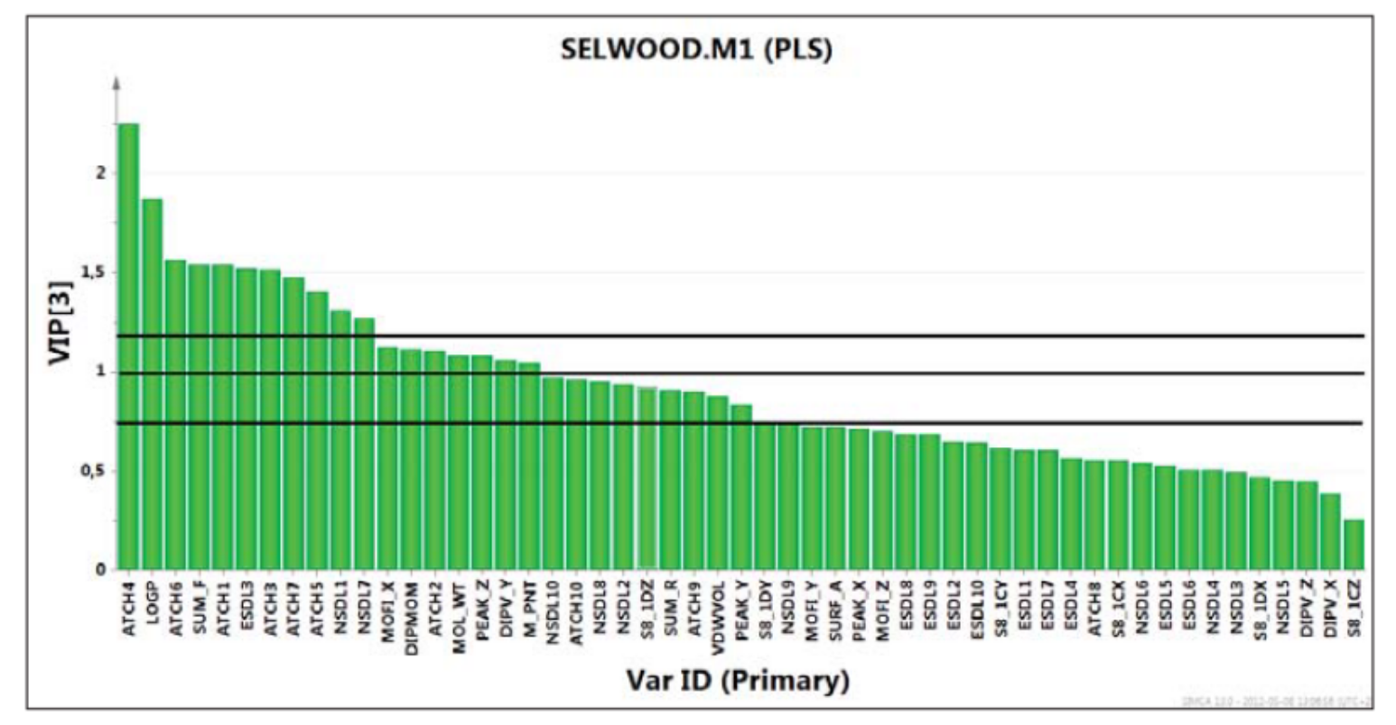
Predictors with large VIP, larger than 1, are most influential for the model.
Most studies either use constant cutoff, or ranking the variables based on VIP score and choose the top k values

Slide 17
PLS validation
We need a model with an optimal balance between fit and predictive ability.
The goodness of fit, R², is used to measure how well the model is able to mathematically reproduce the data of training set.
The goodness of prediction, Q², is used to measure how well the model can predict the result of new testing data.
Notes:
With the model complexity increases, the Q2 will increase and reach to a plateau, then will subsequently decrease.

Slide 18
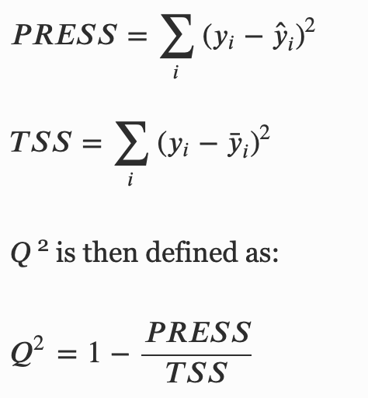
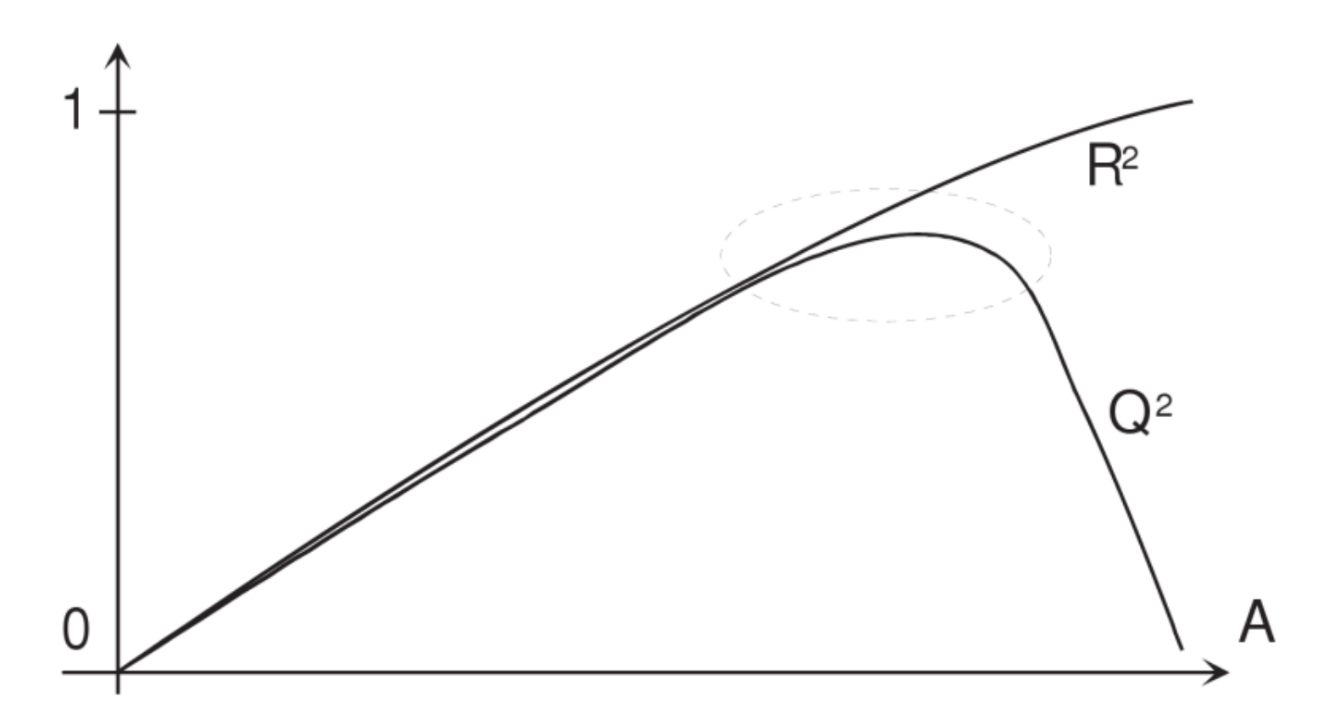
Q²
Q-squared (Q^{‍2}) is the R-squared value that you get from applying the PLS model to the test set instead of the training set.
The Q² is based on the evaluation of the error between the predicted categorical variable
Q² is not inflationary and will not automatically approach 1 with increasing model complexity where on the other hand, the goodness of fit, R², is inflationary and rapidly approaches unity as model complexity increases.
Notes:
The prediction error is summed over all the samples (PRESS) and referred to the total sum of squares (TSS).
In a PLS regression the values of y_{i} hat are not bounded in the range [-1, 1] but, in principle, can assume any value in the range of [- infinity, + infinity].

Slide 19
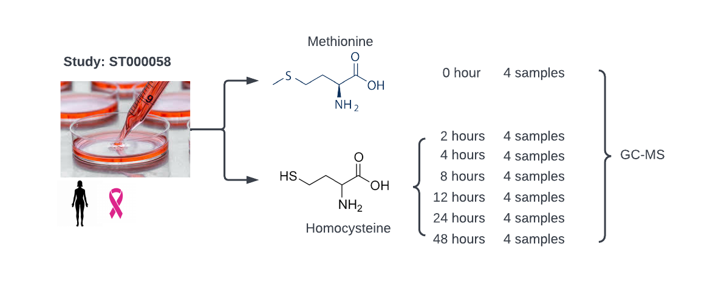
Study example:
ST000058 from Metabolomics Workbench:
GC-MS
Metabolite changes associated with methionine stress sensitivity of cancer

Slide 20
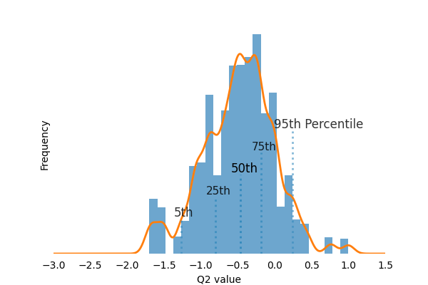
PLS Validation
Permutation test (10,000 times) on Group 1 and Group 7, Q² distribution
Notes:
Add Q2 calculation and explain it.
What is the meaning of increasing R-squared and Q-squared values with increasing number of PLS factors?
R-squared (R‍2) will always increase as you add more PLS factors because it measures the strength of the least-squares fit to the training set activities. More precisely, an R-squared value of 0.9 means that the model accounts for 90% of the variance in the observed activities for the training set. The value gets closer and closer to 1 (i.e., 100%) as more PLS factors are incorporated into the fit.
Q-squared (Q‍2) is the R-squared value that you get from applying the QSAR model to the test set instead of the training set. Since the model is not directly calibrated to fit the test set, Q-squared may or may not increase as you add more PLS factors. But if it's a good model (i.e., it embodies the SAR and you've picked a reasonable number of PLS factors), Q-squared will be comparable in value to R-squared.

Slide 21
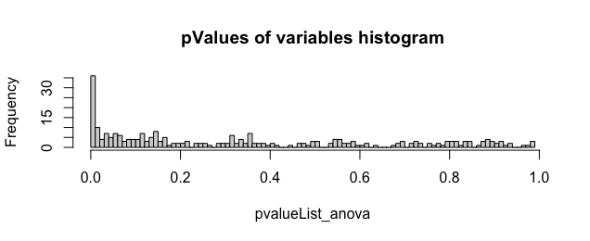
ANoVA test on group 1 and group 7
At 5% false discovery rate, the number of significant variables is 26.
At 10% false discovery rate, the number of significant variables is 43.
With VIP score threshold >1.0, there are 117 variables
With VIP score threshold > 1.3, there are 62 variables
With VIP score threshold >1.5, there are 40 variables

Slide 22
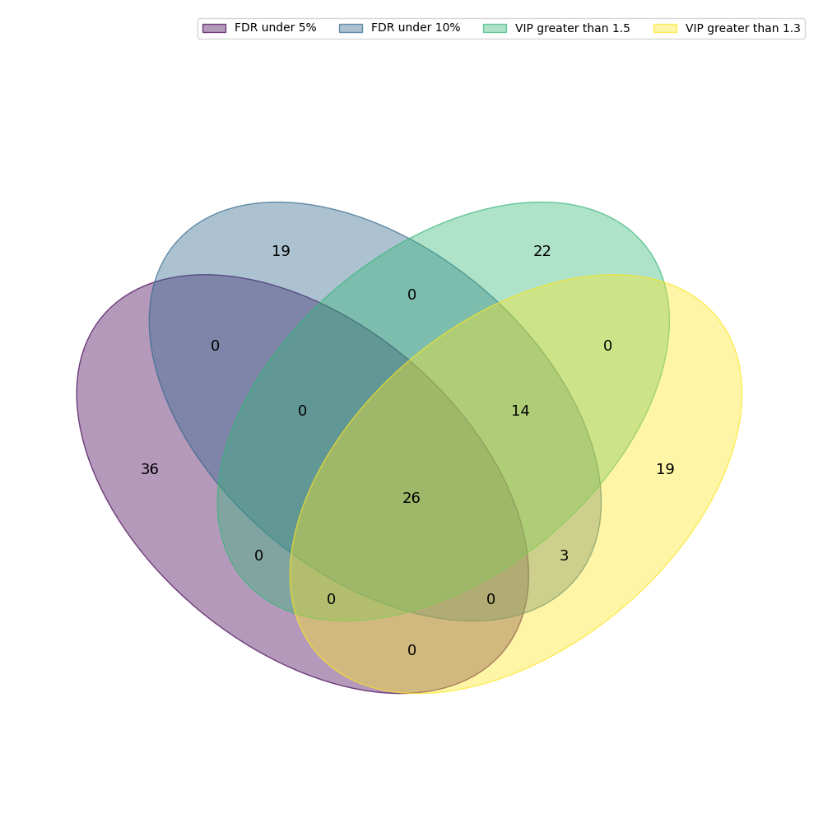
Compare results between ANoVA and VIP
With VIP score threshold > 1.3, there are 62 variables, including all 43 variables under 10% FDR
With VIP score threshold >1.5, there are 40 variables, including all 26 variables under 5% FDR.

Slide 23
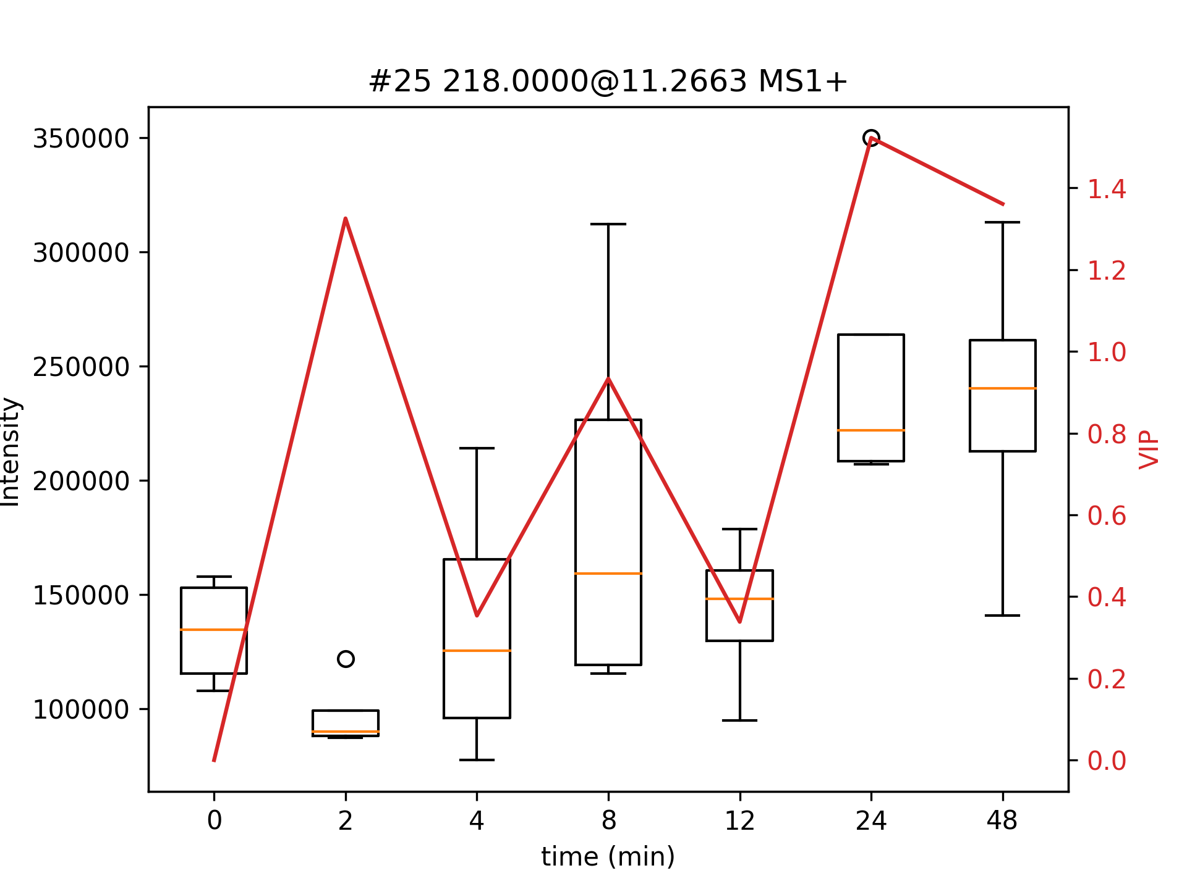
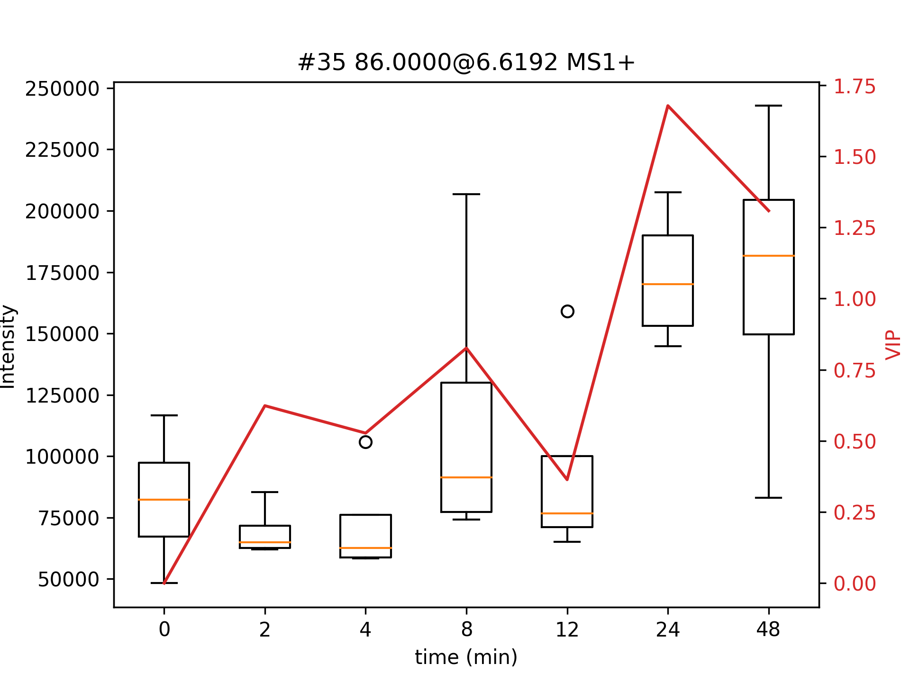
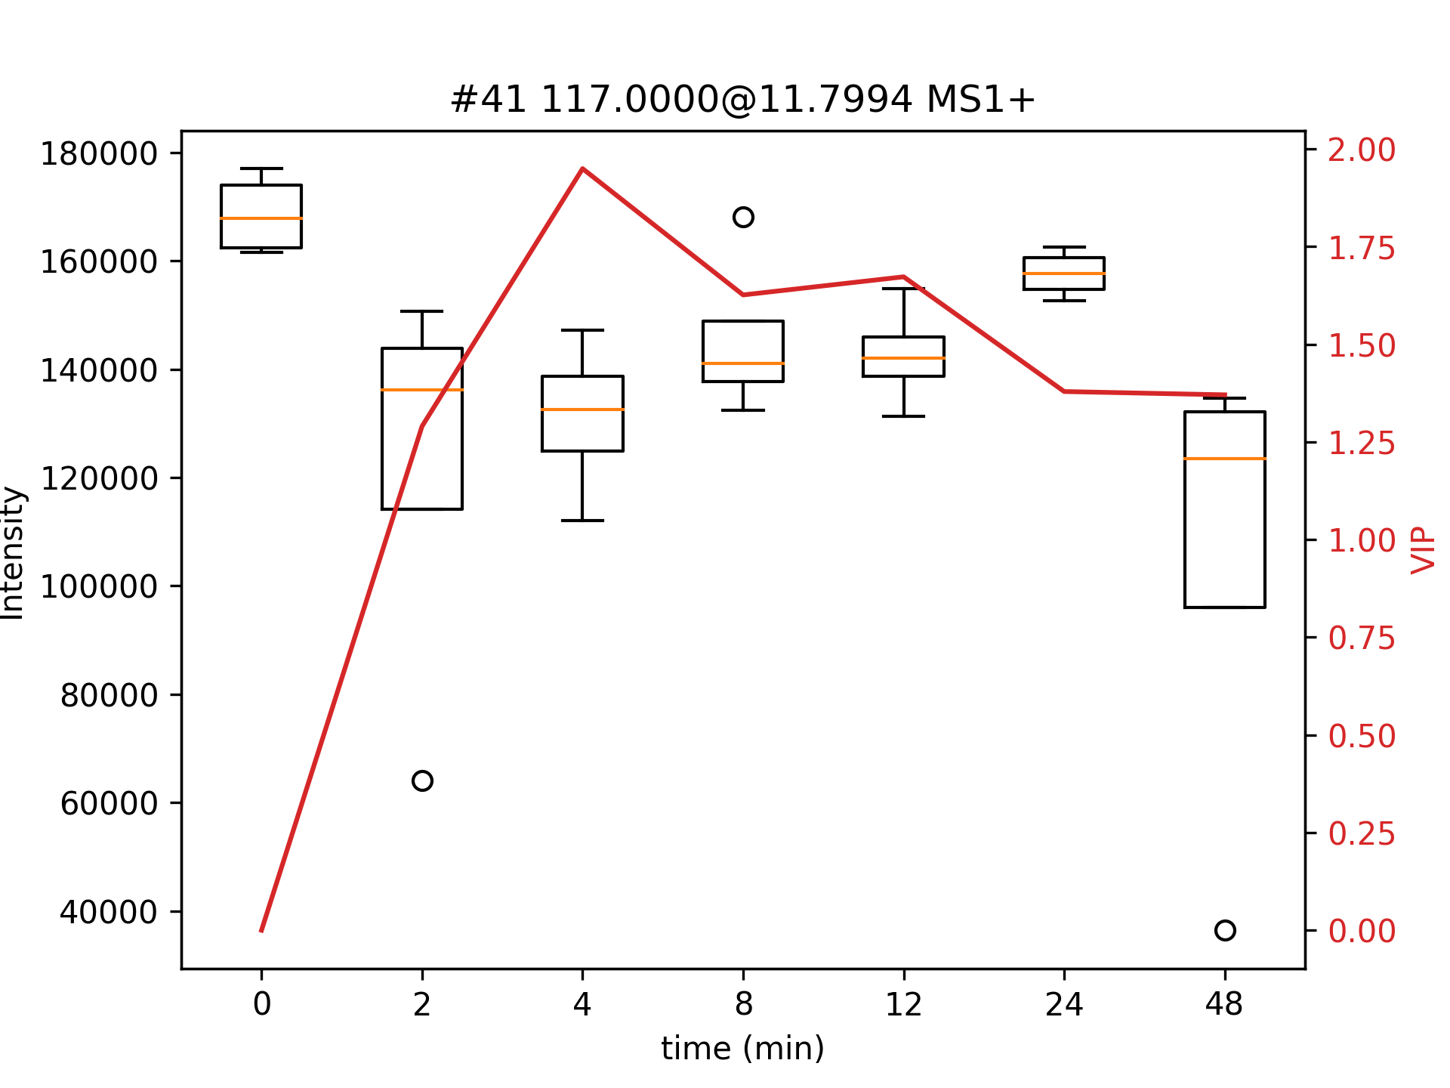
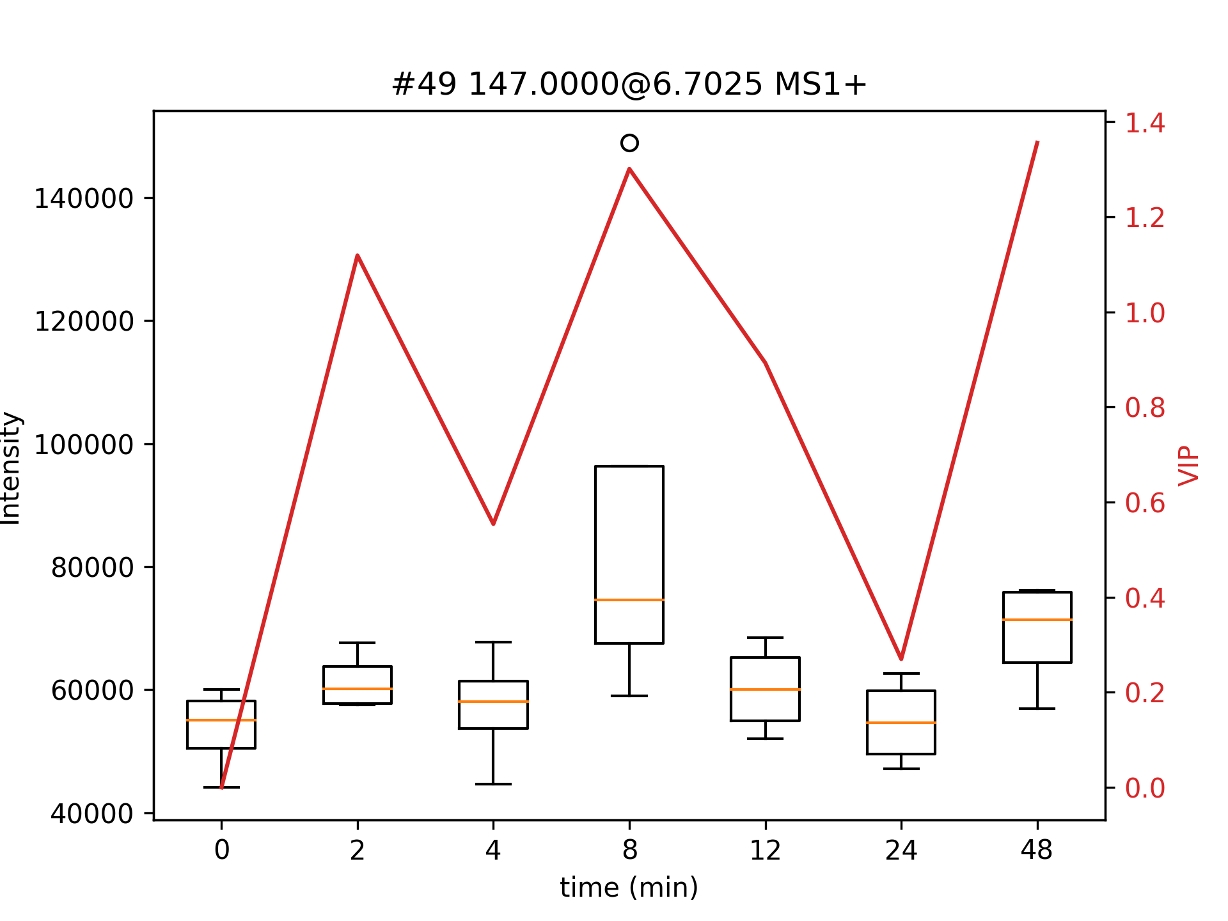
Metabolites with VIPs (>1.3) not in FDR 15%
The plot shows the intensities of each compound over the time of treatment.
On the X-axis, the 0 is the reference group, from 2 to 48 are the PLS-DA models between control group and other groups, individually.
On the Y-axis, the left Y-axis is the intensity of this metabolite and the right Y-axis is the VIP score.

Slide 24
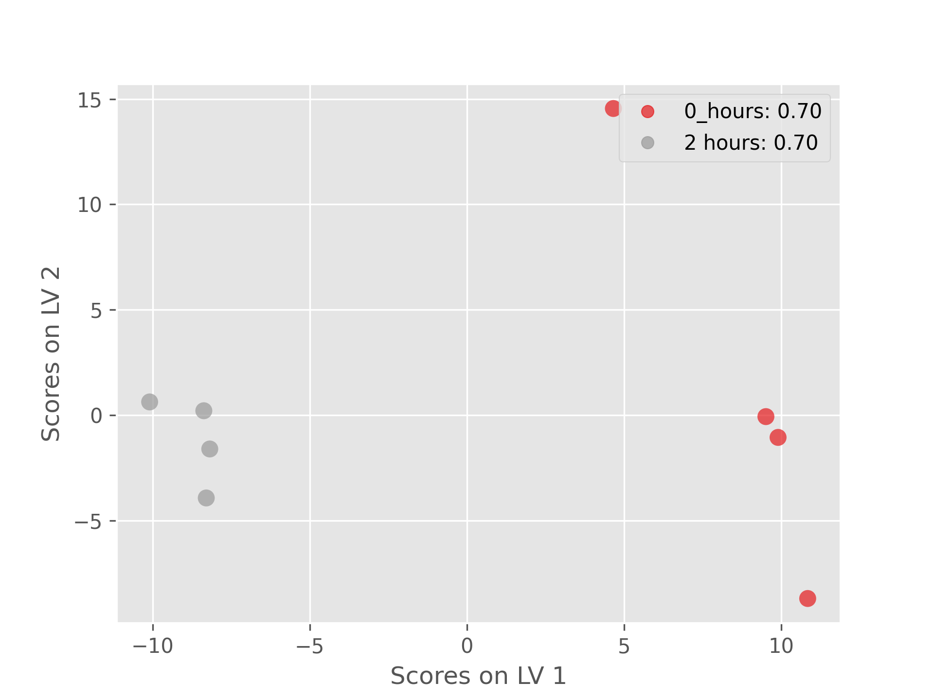
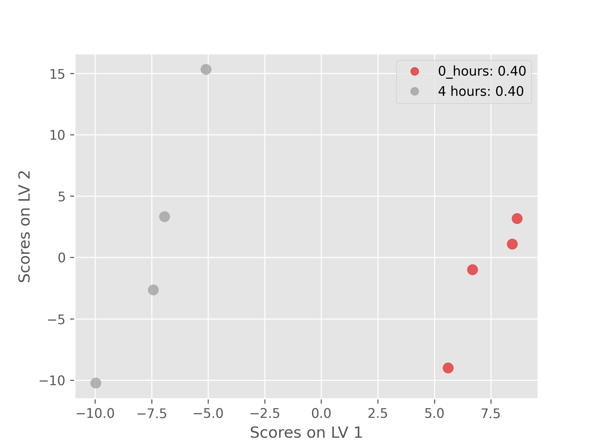
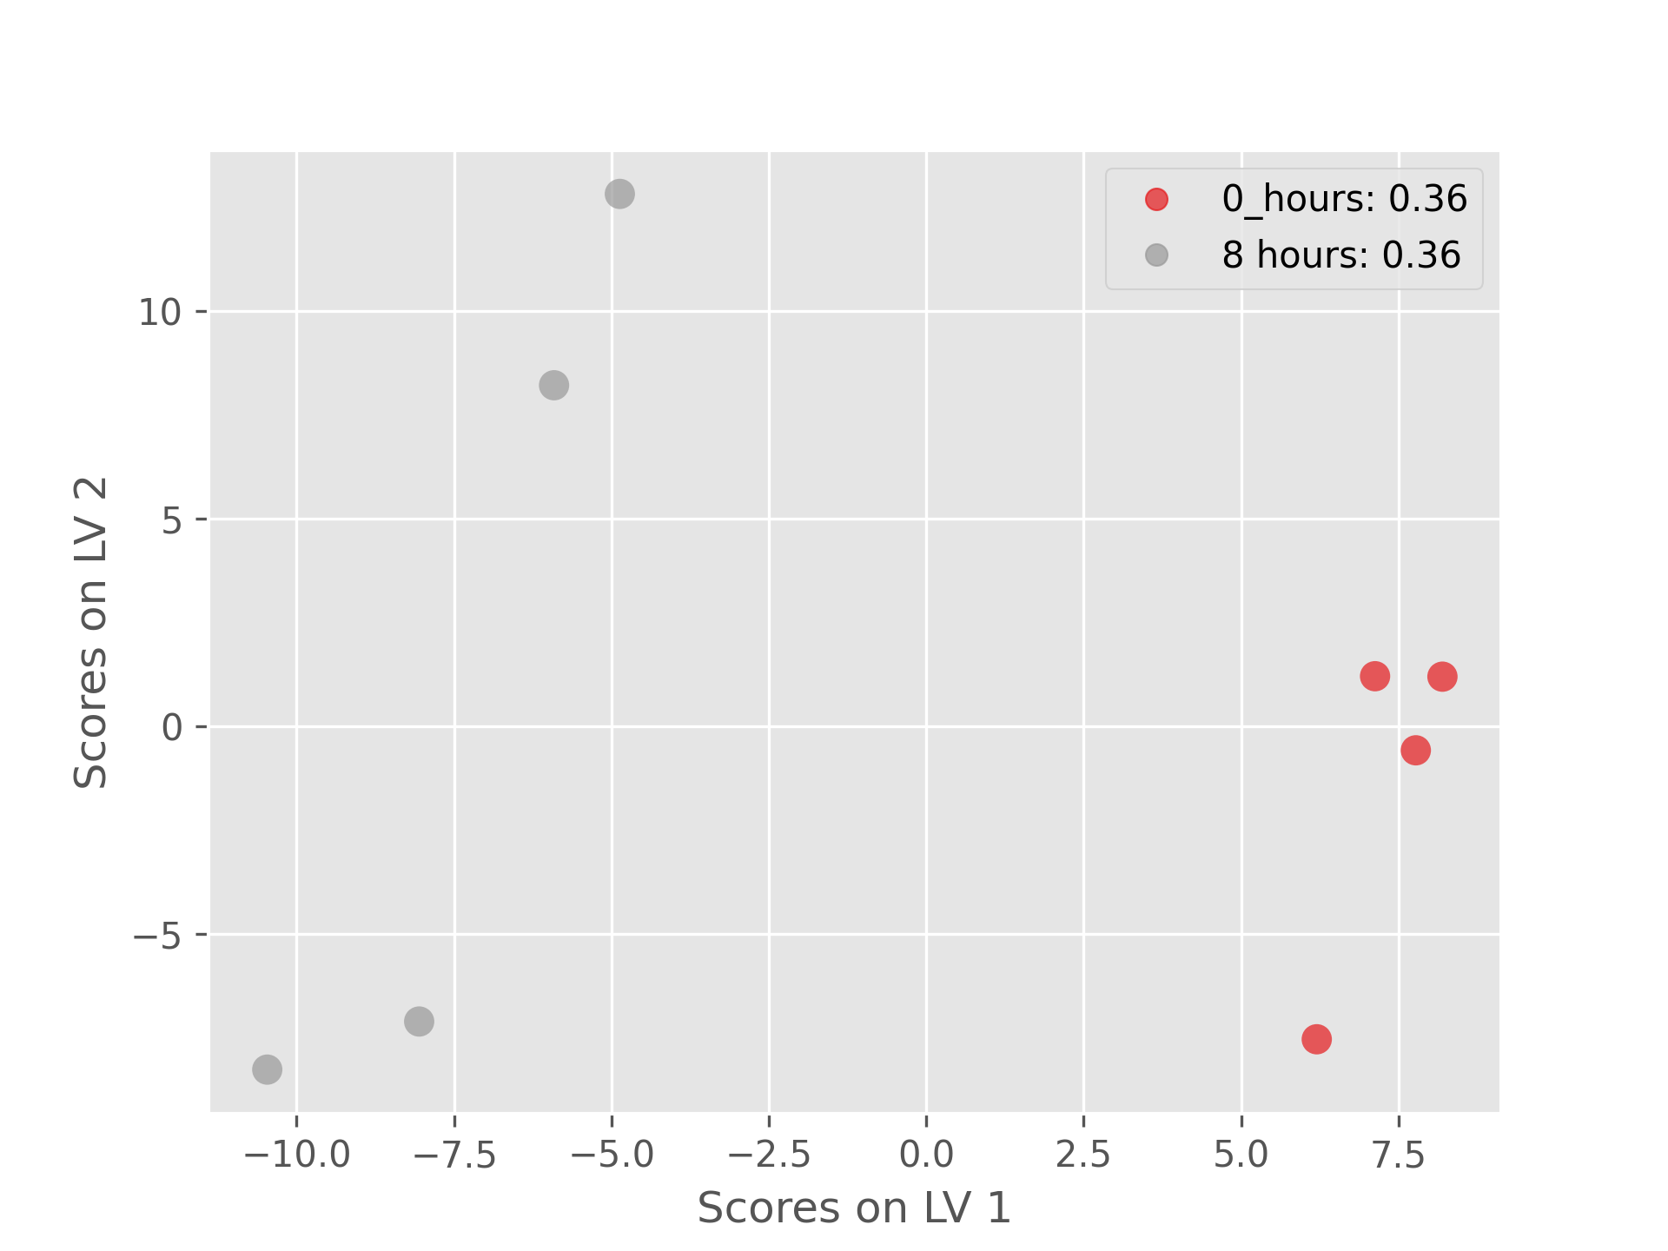
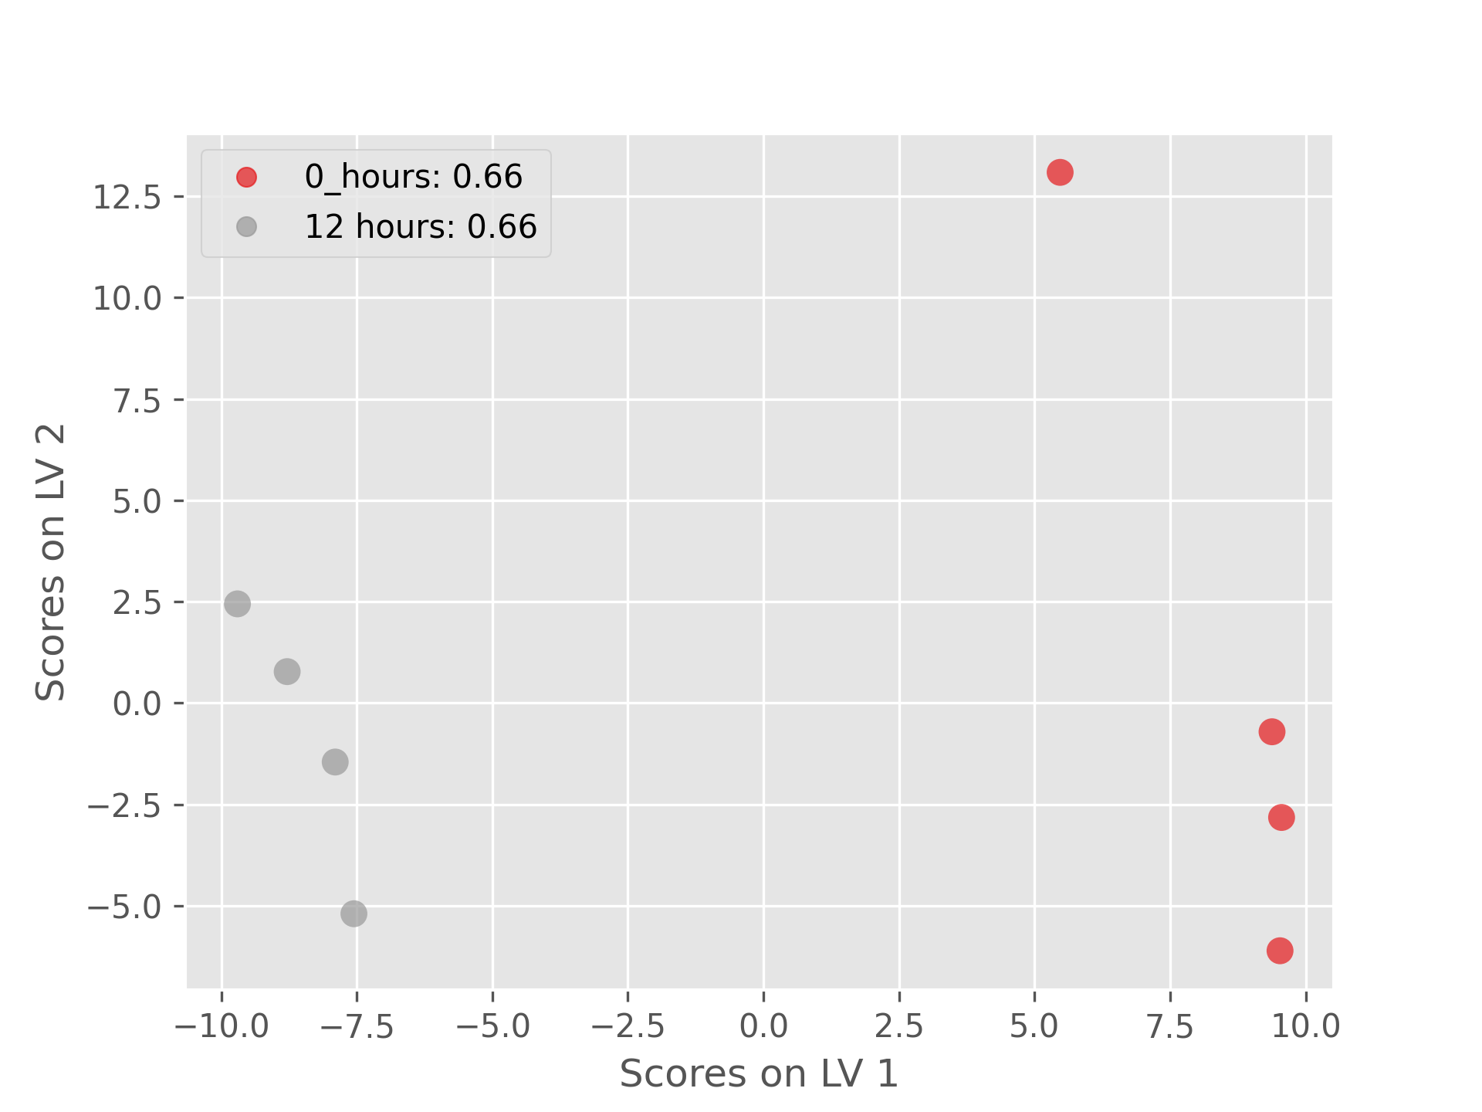
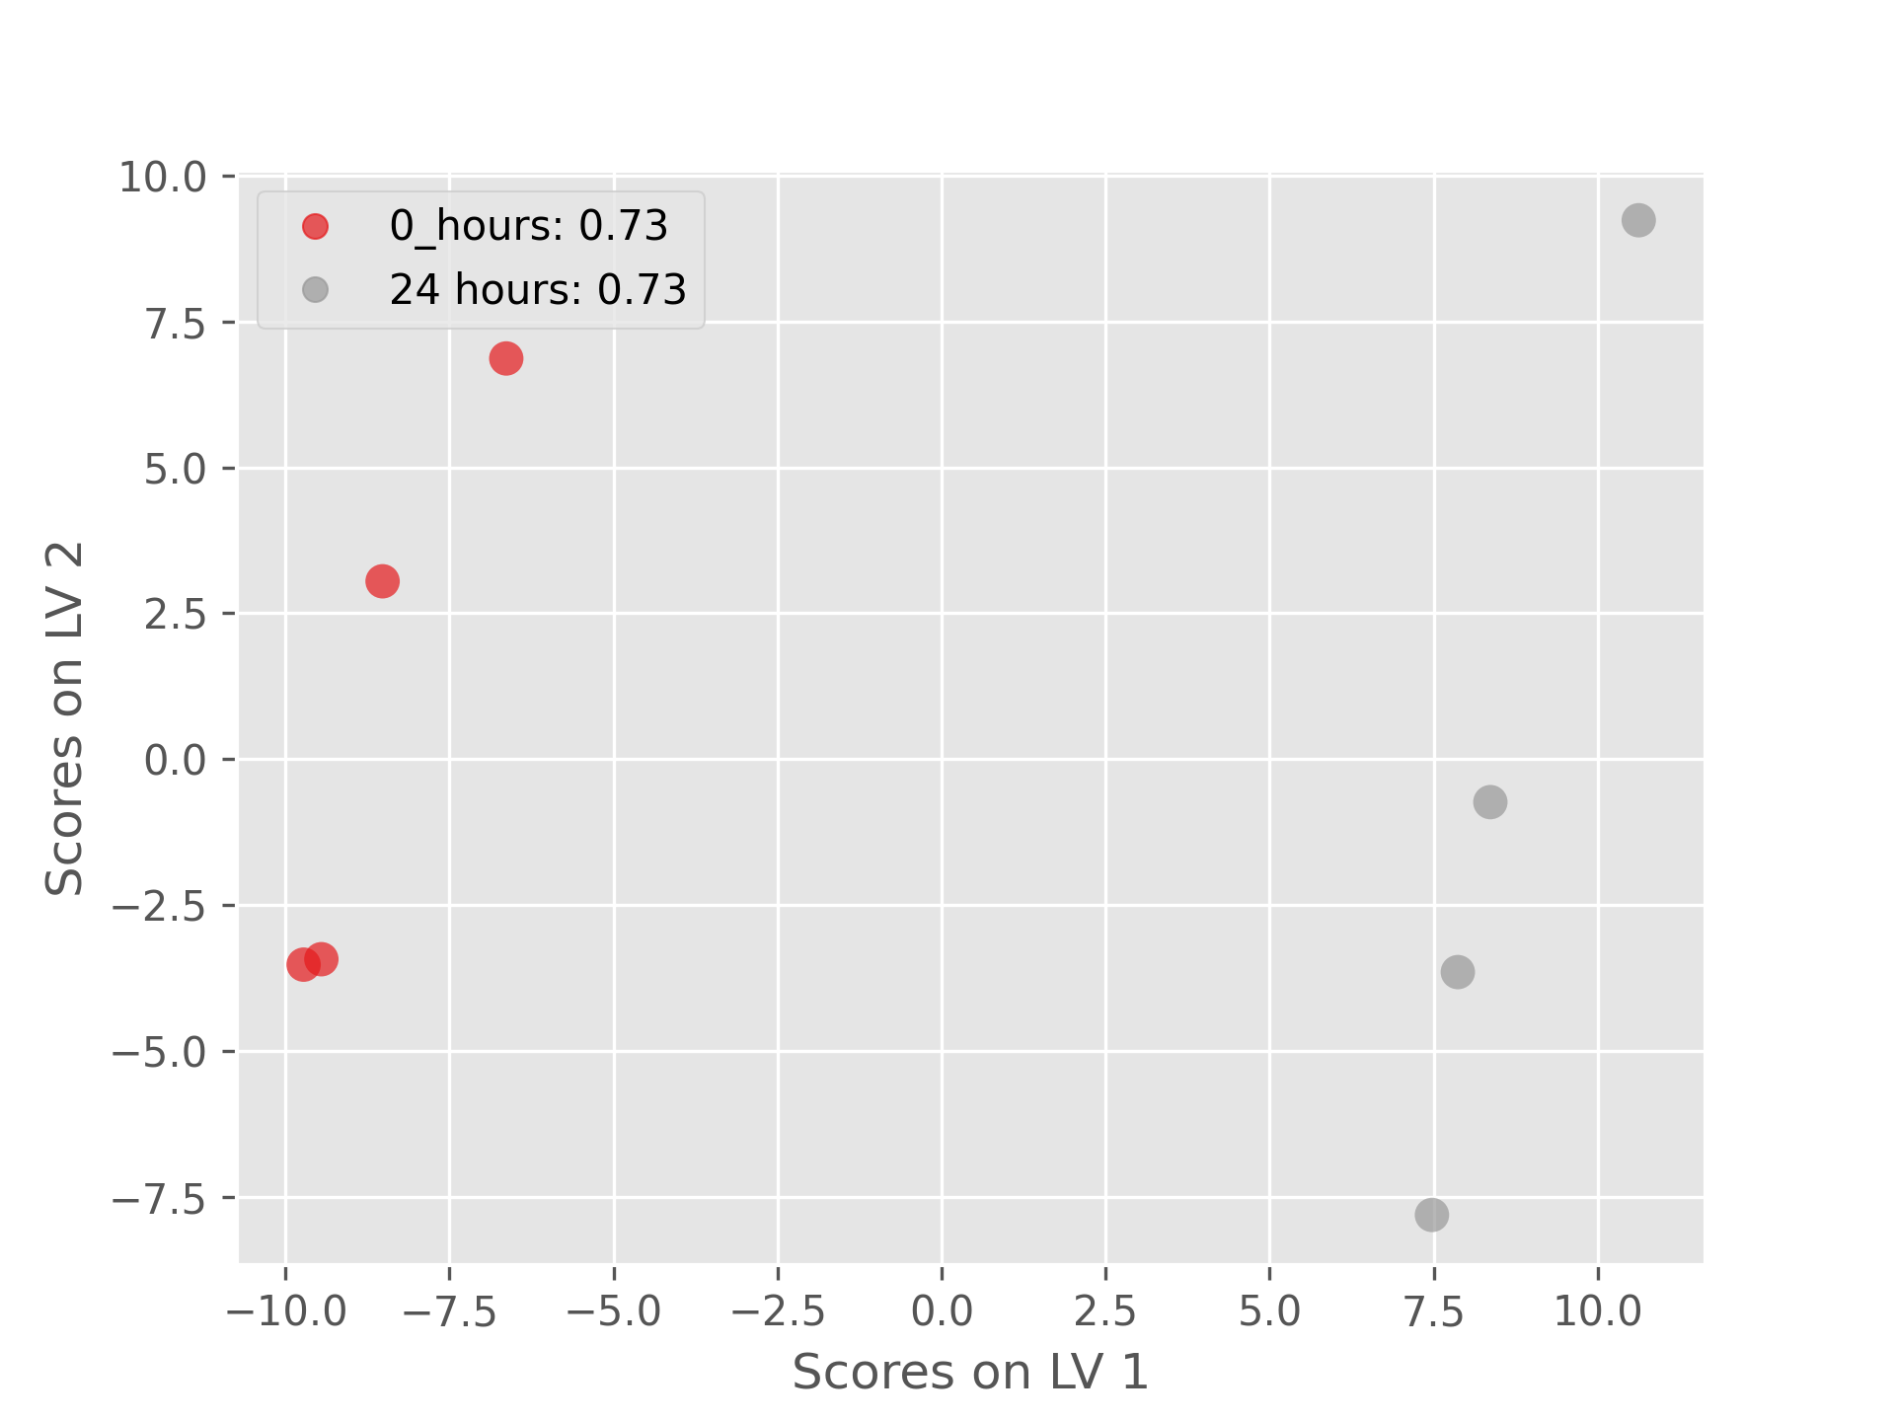
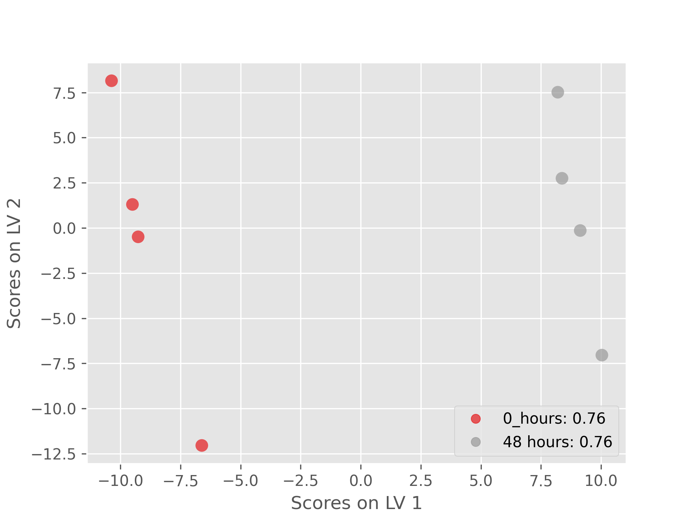
PLS-DA score plots for homocysteine treatment with different time
Fig. The figures above are from different PLS-DA model between control group and group of treatment under 2 to 48 hours.

Slide 25
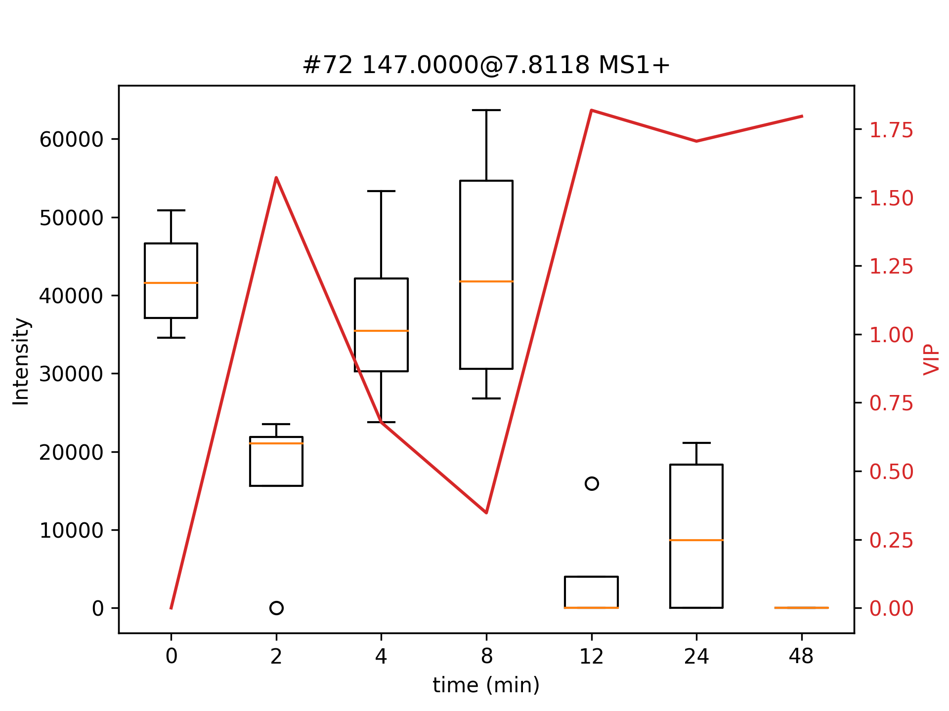
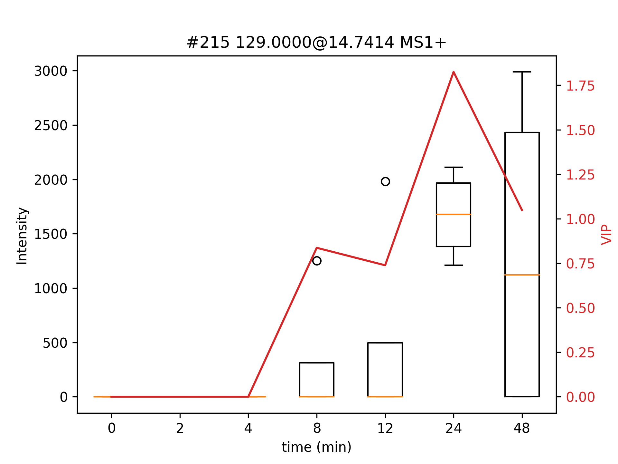
To better interpret the PLS-DA score plot:
Same as previous figs.
Notes:
A VIP score is a measure of a variable's importance in the PLS-DA model. It summarizes the contribution a variable makes to the model. The VIP score of a variable is calculated as a weighted sum of the squared correlations between the PLS-DA components and the original variable.

Slide 26
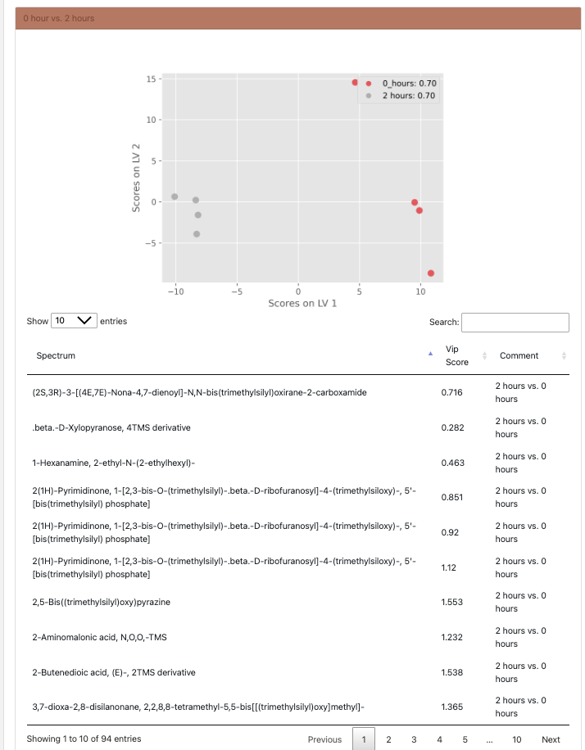
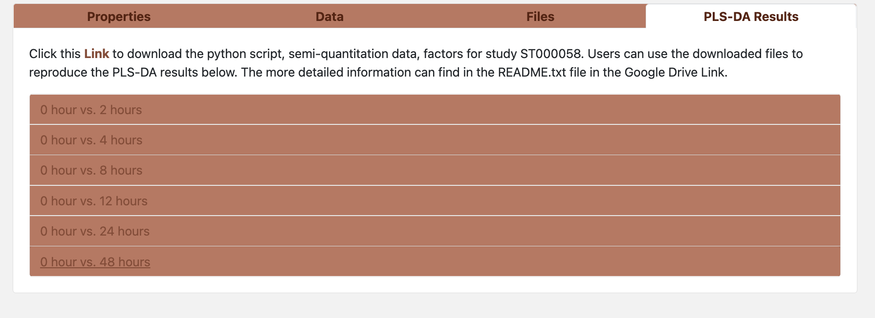
PLS-DA display function ADAP-KDB^{[1]}:
[1] Aleksandr Smirnov, Yunfei Liao, Eoin Fahy, Shankar Subramaniam, and Xiuxia Du
Analytical Chemistry 2021 93 (36), 12213-12220
Notes:
ADAP-KDB, a cloud-based mass spectral knowledgebase, has been built for sharing and aggregating untargeted gas chromatography and liquid chromatography mass spectrometry data from many metabolomics studies.
Users can search their own mass spectra against spectra in ADAP-KDB to discover metabolomics studies where similar spectra have been observed.

Slide 27
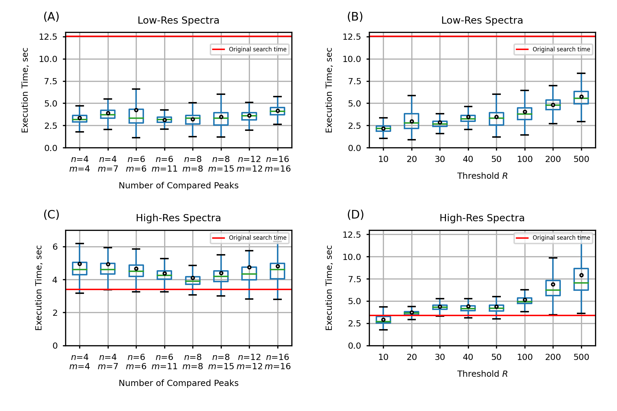
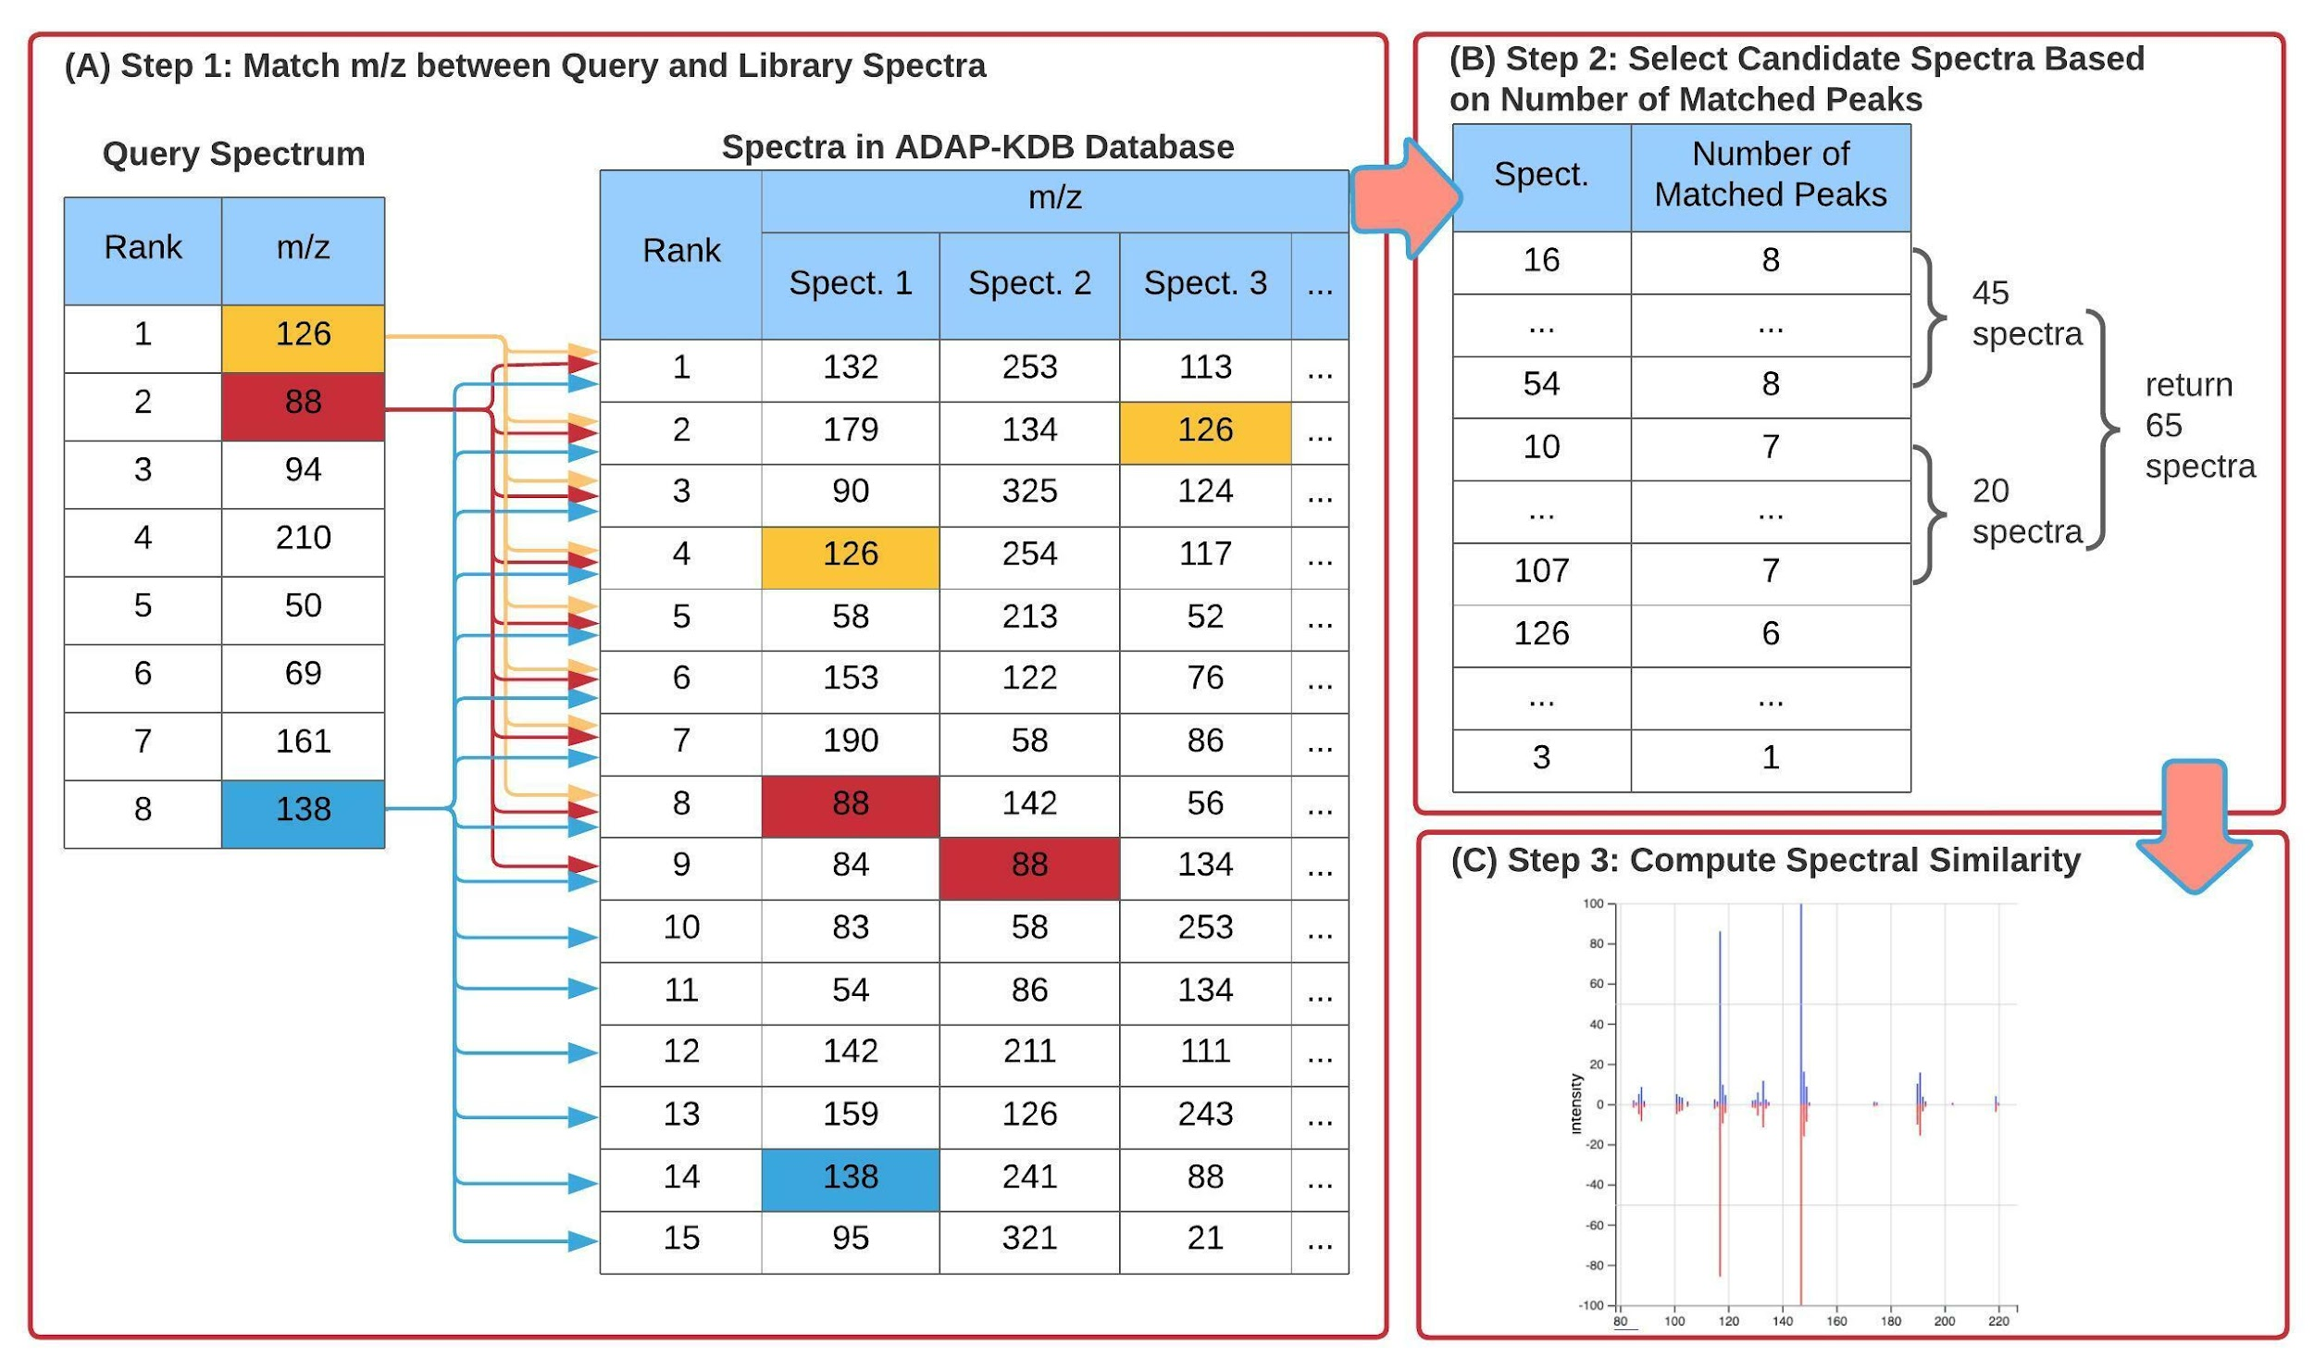
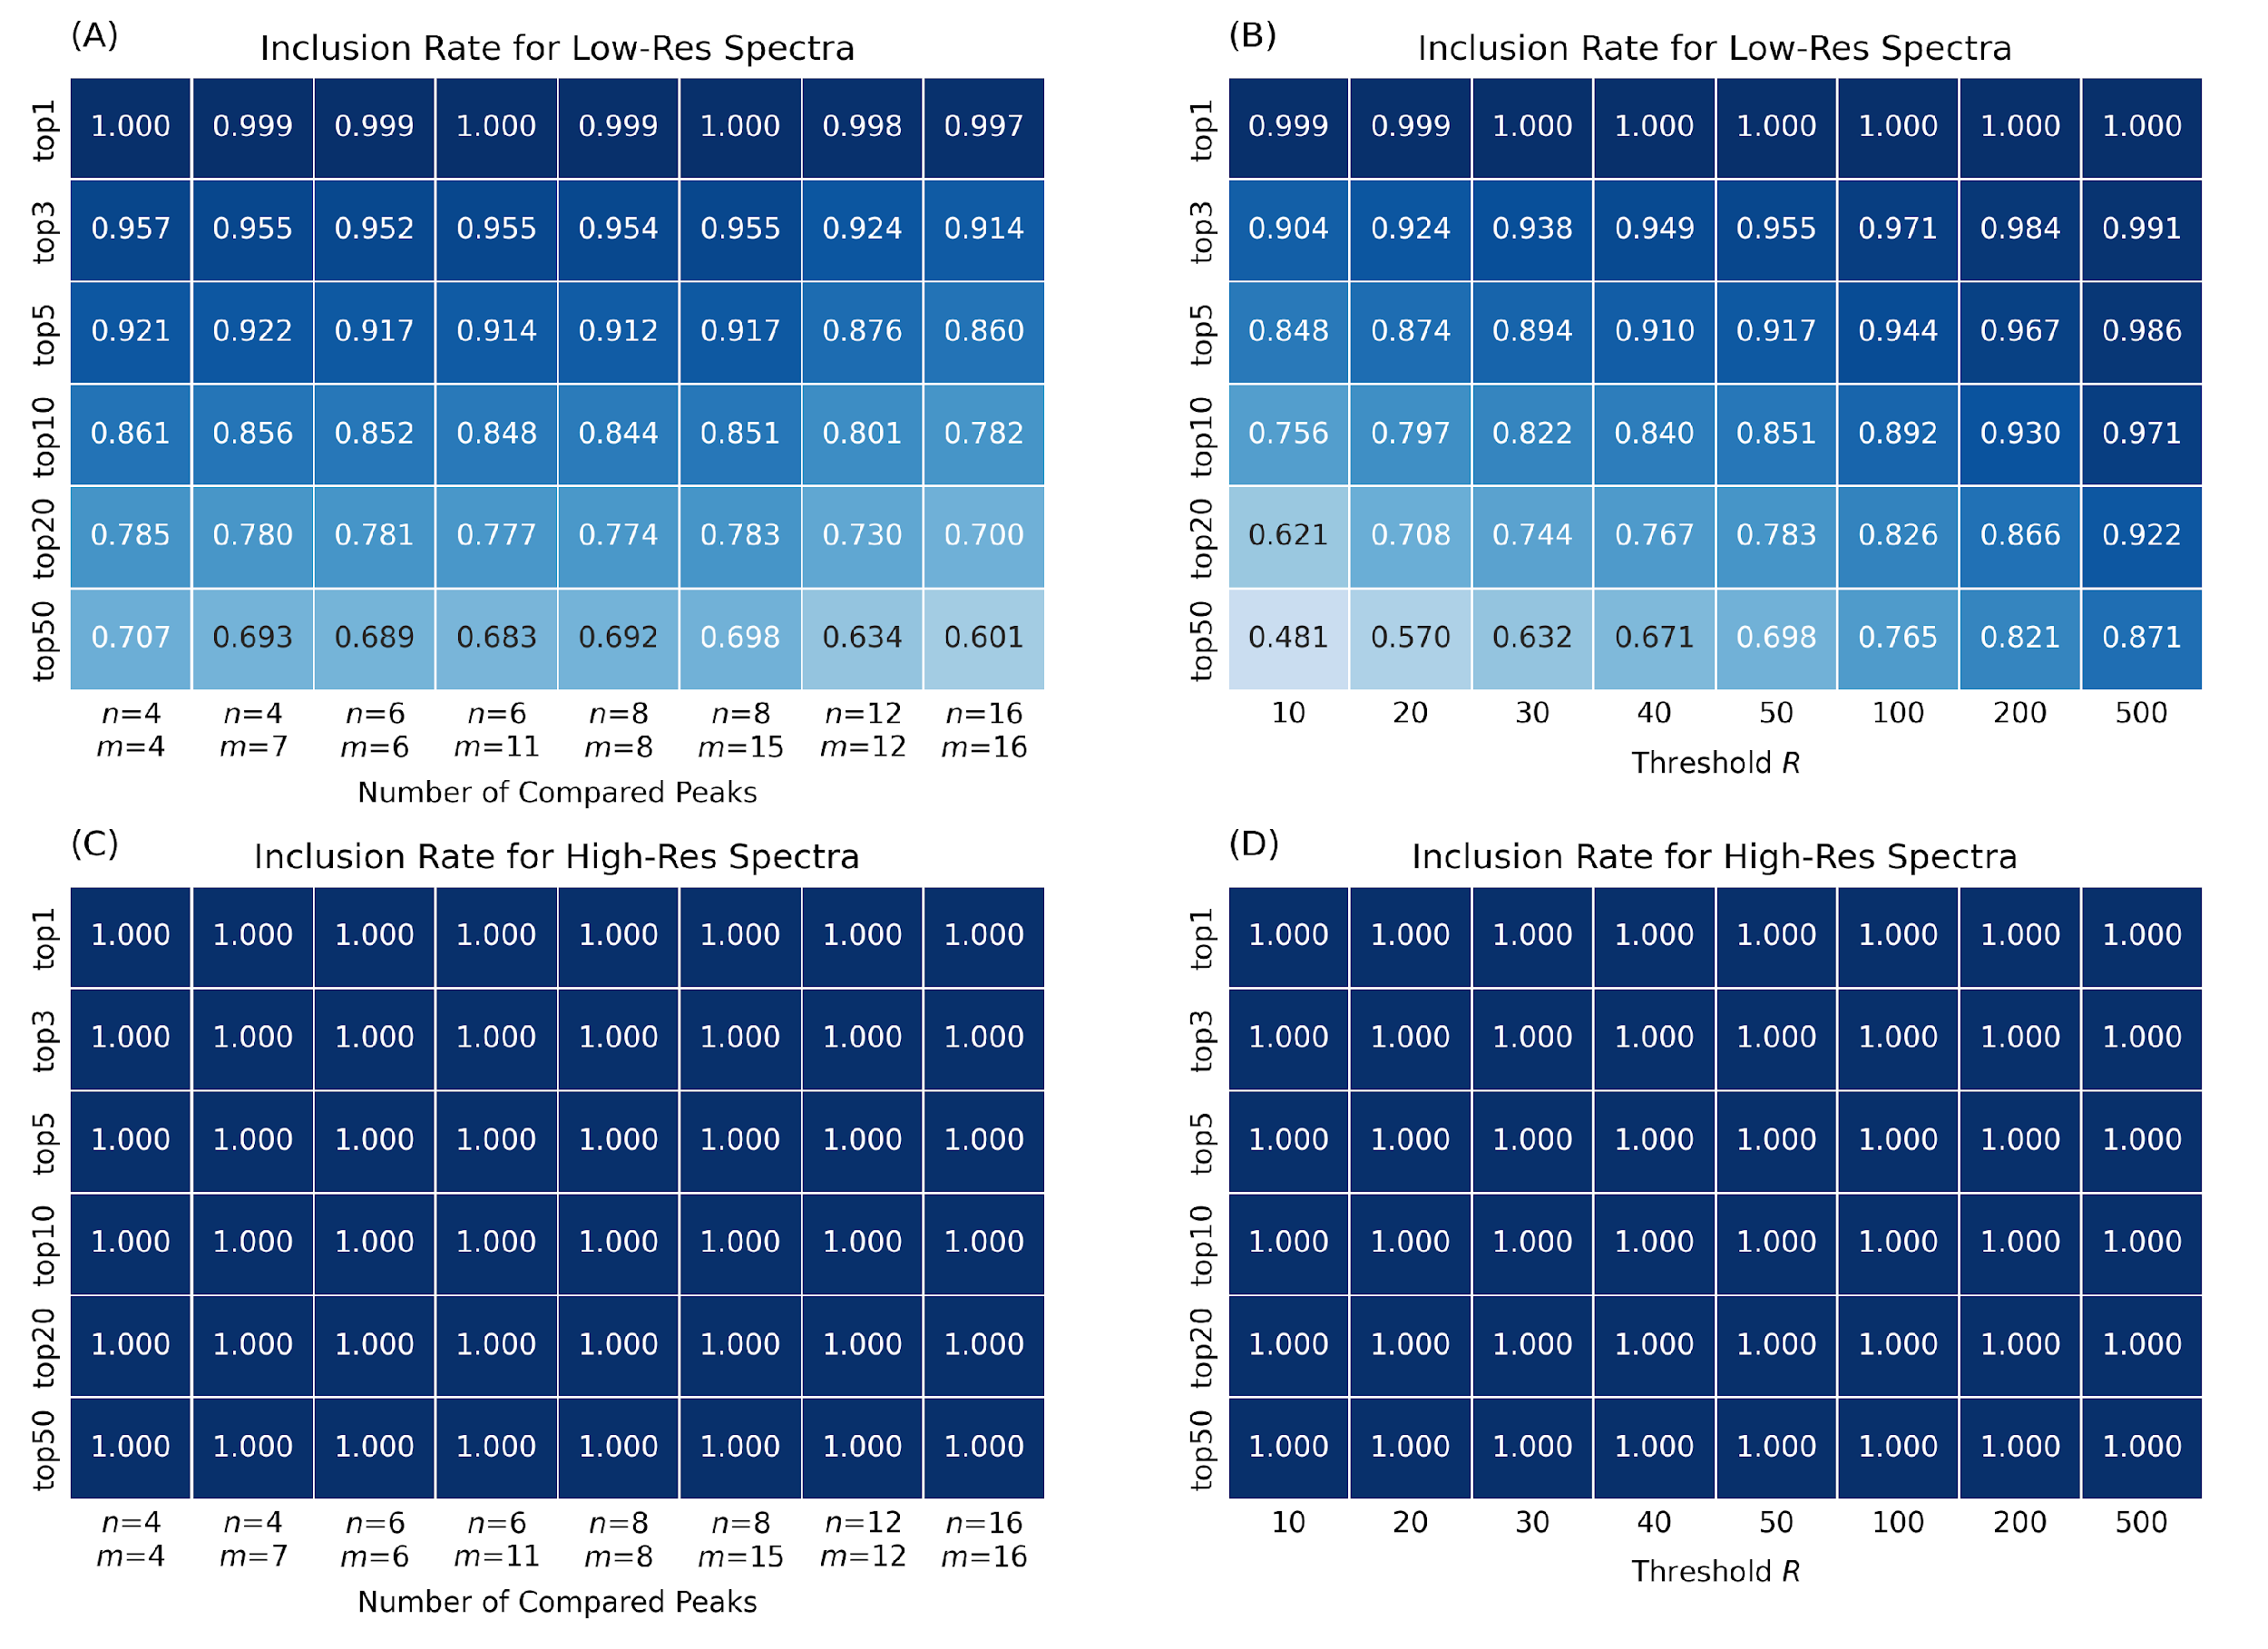
For ADAP-KDB:
1. Implement pre-screening method to speed up the spectral search for similar spectra ^{[1]}
[1] Smirnov, A.; Liao, Y.; Du, X. Memory-Efficient Searching of Gas-Chromatography Mass Spectra Accelerated by Prescreening. Metabolites 2022, 12, 491.
Notes:
We calculated the average number of matching peaks with close m/z values during the search of low-mass-resolution and high-mass-resolution spectra. Indeed, when a mass spectrum at low resolution is compared against the ADAP-KDB library, the Peak table contains 27 matching peaks on average for each query m/z value. However, when a mass spectrum at high resolution is compared against ADAP-KDB, the average number of matched peaks from the Peak table is only 4.9 for each query m/z value. Therefore, the number of rows returned by the lines 3–9 of the SQL query in the original algorithm (Figure 1) is about 5 times greater for a low-mass-resolution query spectrum than that for a high-mass-resolution. This explains the substantial differences in the search times between the spectra at low and high resolutions.

Slide 28
Future Plans:
Processing more metabolomics studies from public repository based on the diseases and sample sources and look for potential biomarkers.
Validation of such biomarkers is of great importance, as is the biological understanding of the disease that can provide additional validation in the application of metabolomics. (Such as using MarkerDB and publicly available publishes)
Exploring UK BioBank NMR data to looking for more useful information for potential biomarkers based on diseases and other categories. Also, hopefully we will also be able to use UK BioBank data to validate the biomarkers we found in public studies.
Understand more about metabolic pathway identification, combine with biomarker to explore the pathogenesis of diseases. Along with learning more about instrumentations to help me better understand and interpret metabolomics studies.
Potentially to build or help improve a biomarker database.

